Slide 1
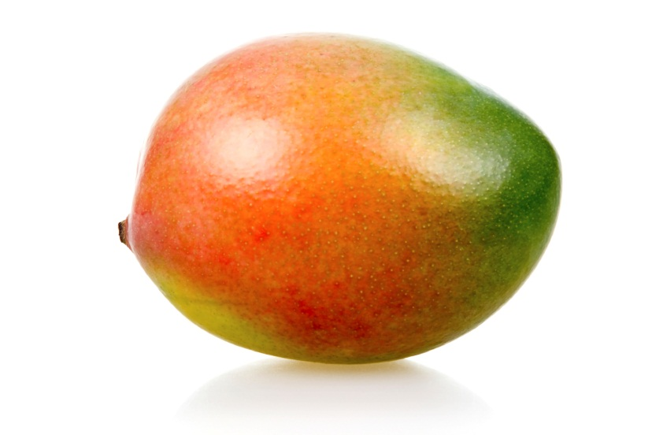
OOP Team Mango
Classic RPG

Slide 2
Game Description
In our game you will find a number of interesting opponents, inventory, thrilling battles, epic weapons and… RoboPesho!
The game is actually a working inventory with different slots for different types of useful items.
The game also gives opportunity for multiple battles and slight progression of gaining more items.
The player can change his equipment after every battle.
All objects except the player have 2D graphics (downloaded from web space).
Base data types in class library:
Entity: base abstract class for playing objects (player and enemies)
Player: can use inventory and all actions implemented within it.
Enemy: same function as Player, but with automated actions and has no inventory.
Ability: abstract class uniting all possible actions of the playing objects.
Game Action: all actions between two playing objects happen with objects inheriting this abstract class.
Item: the class contains images for all objects. All items inherit this class.
UI: three functional windows. One for battle, one for inventory and one for between the battles.
Factories: creates random enemies with preset options.
Item Factory: constructor allowing creating different objects from one constructor.

Slide 3
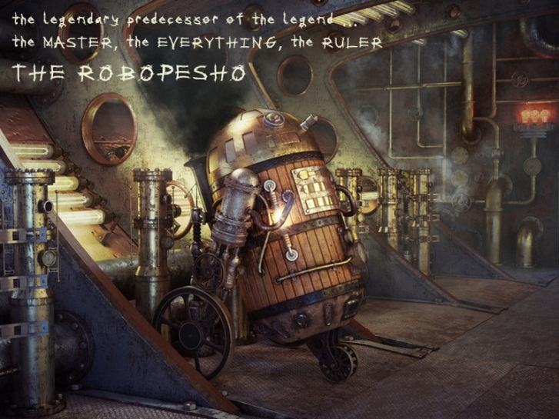
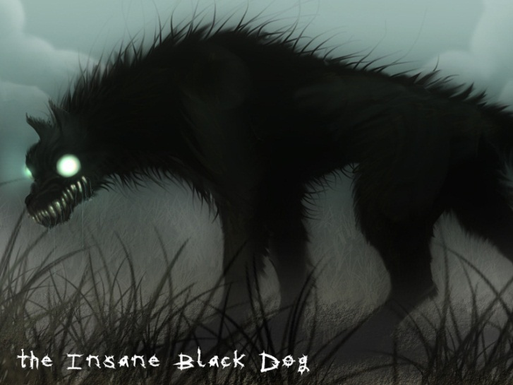
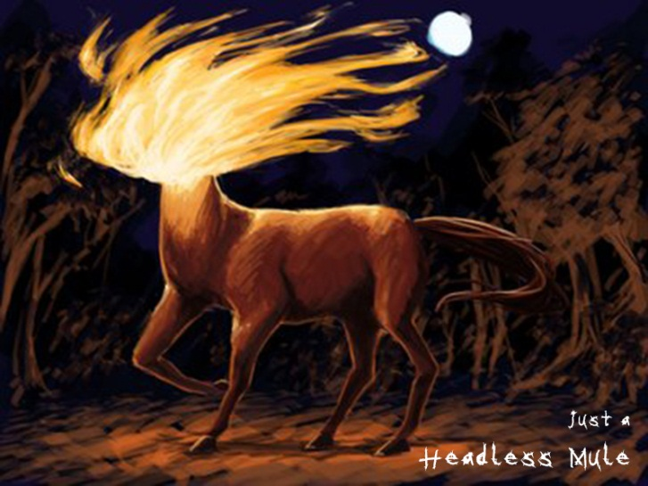
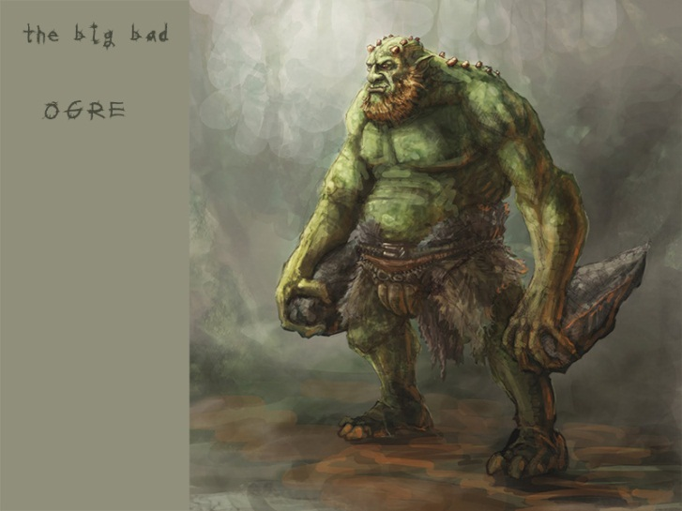
Enemies

Slide 4
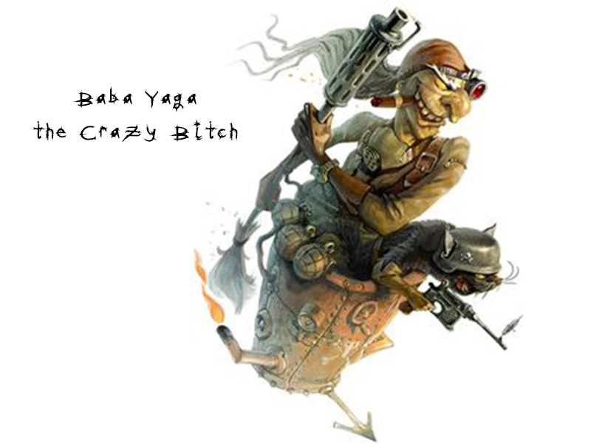
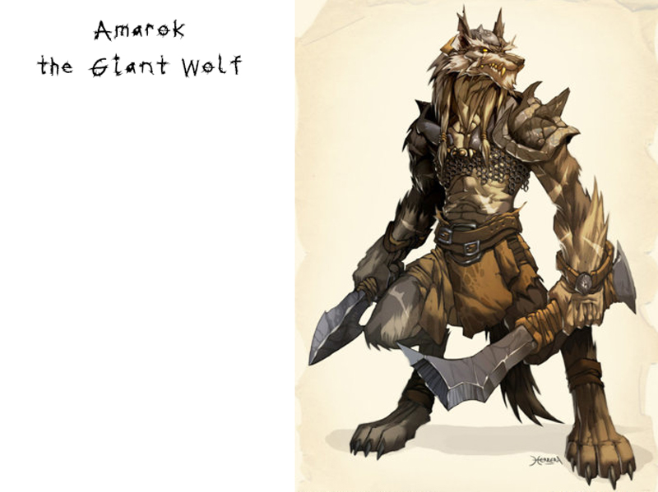
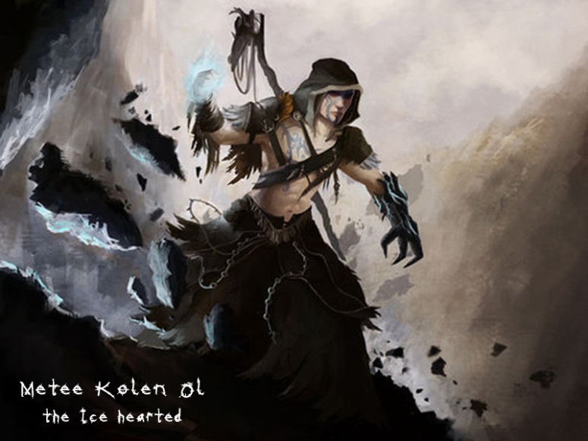
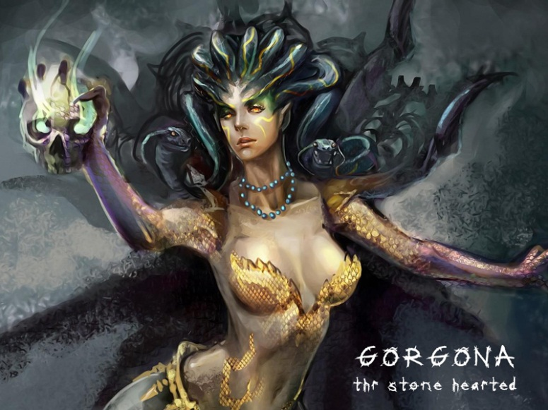
More Enemies

Slide 5
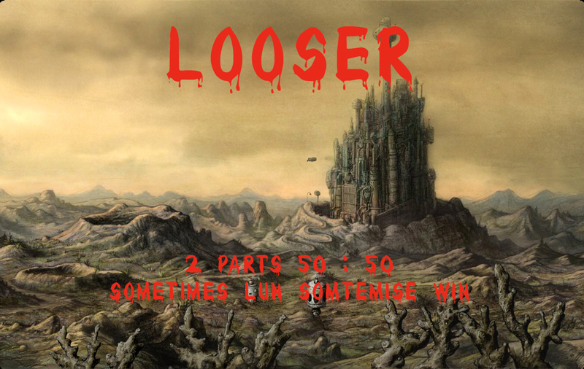
Sometimes lun, sometimes win

